Slide 1
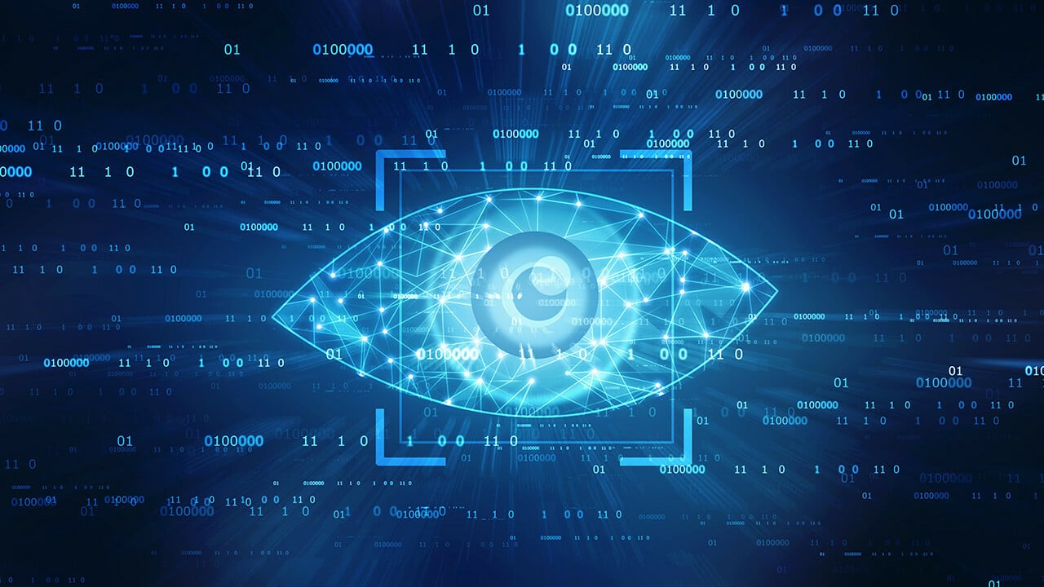
FACE DETECTION USING OPEN CV
Done by Mentor
DAMA LOKESH Mr.v.manikandan

Slide 2
Table of Contents
Introduction
About Software tool
Usage of Software tool
Reported Literature
Objective of Project
Timeline of work proposal
Used algorithm
Work done in step by step description
Results and discussion
Summary
References

Slide 3
Introduction
Face detection is a computer programme that locates and measures human faces in random (digital) images or real time video streaming etc. It recognises facial traits but ignores everything else, including bodies, buildings, and trees.
The computer vision community is currently engaged in research on human facial perception. In applications like video surveillance, human computer interface, face recognition, and picture database management, the first step is frequently to locate and detect human faces.
It is necessary to find and monitor human faces in order to do face recognition and/or facial expressions analysis, despite the fact that this is frequently considered to be the case. The Haar-Classifier for Face detection and tracking based on the HaarFeatures will be implemented in this study.
.

Slide 4
About Software Tool
Computer Vision is the software tool used for face detection.
Computer vision is a field of artificial intelligence (AI) that enables computers and systems to derive meaningful information from digital images, videos and other visual inputs.
It involves the use of algorithms and mathematical models to interpret and analyze digital images and videos, to see and understand the visual world like humans do.
The exciting and fast developing topic of computer vision has the ability to completely change our daily lives, including healthcare, transportation, entertainment, and education.

Slide 5
About Software Tool
OPENCV: Developed by Intel, OpenCV (Open Source Computer Vision Library) is a library of programming functions primarily focused on real-time computer vision. It is cross-platform, the library. It largely focuses on in-the-moment image processing . Since the library was initially created in C, OpenCV is adaptable to a variety of systems, including digital signal processors. To promote adoption by a larger audience, wrappers for languages like C#, Python, Ruby, and Java (using Java CV) have been created. From version 2.0, OpenCV has a new C++ interface in addition to its classic C interface. With the help of automatic data allocation and deallocation, this new interface aims to decrease the number of lines of code required to build vision functionality as well as common programming issues like memory leaks that can happen when using OpenCV in C. Now, the majority of OpenCV's new features and algorithms are created via the C++ interface. However, it is far more challenging to create wrappers for C++ code than it is for C code, hence several of the more recent OpenCV 2.0 features are typically absent from the wrappers for other languages

Slide 6
Usage of Software Tool
Computer vision is used to detect and classify objects (e.g., road signs or traffic lights).
Computer vision tools are widely used in a variety of applications in various industries. Here are some examples of how computer vision tools are used:
Object recognition and tracking: Computer vision tools are used to detect and track objects in real-time video services.
Facial recognition: Computer vision tools can identify and recognize faces in images and videos.
Robotics: Computer vision tools are used to enable robots to perceive and interact with their environment.
Computer vision tools have many other applications in various industries, and their usage is rapidly growing as technology advances.

Slide 7
Reported Literature
Paper title | Author | Methodology | Journal | Year of publication | Demerits
"Real-time face detection using OpenCV" | Bradski, G. | Viola-Jones algorithm with Haar-like features | ACM Workshop on Computer Vision, pp. 137-154 | 2008 | Requires high computation power
"Robust Real-Time Face Detection" | Yang, M.H. et al. | Boosted Cascade of Simple Features (BCSF) algorithm | IEEE Conference on Computer Vision and Pattern Recognition (CVPR), pp. 1-8 | 2007 | High false positive rate
"Facial Detection and Tracking using OpenCV" | Bradski, G. | Cascade Classifier with Haar-like features | Dr. Dobb's Journal, pp. 44-50 | 2008 | Limited detection accuracy
"Efficient Face Detection Method for Mobile Applications" | Le, T.H. et al. | Faster R-CNN algorithm | International Conference on Advanced Technologies for Communications (ATC), pp. 85-90 | 2017 | Slow detection speed
"A Comparison of Face Detection Algorithms" | Ramoser, H. et al. | Viola-Jones algorithm with Haar-like features, Adaboost, SVM, and HOG | IEEE International Conference on Computer Vision Theory and Applications (VISAPP), pp. 173-181 | 2015 | Limited performance in complex scenarios

Slide 8
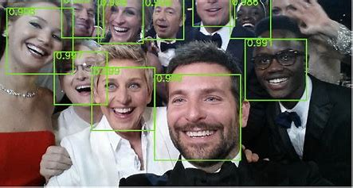
Objective of project
The objectives for a face detection project can vary depending on the specific application and requirements, but some common objectives could include:
face detection is to locate human faces within an image or a video frame.
In face detection the camera only detects the presence of human face and ignores the rest of the objects.

Slide 9
Timeline of Work Proposal
 | Intended outcome
Week 1 | Learnt about Analyzing and Classifying Images with the Computer Vision Service
Week 2 | Learnt about Detect objects in images with the Custom Vision service
Week 3 | Learnt about Analyze Faces, Text, and Receipts with Azure Al
Week 4 | Chosen a project based on computer vision tool and learnt about how the project works.
Week 5 | Done with executing the code for the project.
Week 6 | Done with ppt and report for review

Slide 10
Used Algorithm
With the help of the Raspberry Pi BCM2835 CPU processor, a SoC with GPU-based Architecture, we want to implement real-time face detection and head pose tracking from high definition video using the Haar Classifier. For face detection and tracking the position of the head in poses, libraries like SimpleCV and OpenCV are employed.
The experiment's calculated outcome made with computer vision For improved accuracy and speed for face detection and monitoring the location of the head poses, results were obtained using 30 fps under 1080p resolutions using the SimpleCV and OpenCV framework libraries along with the aforementioned hardware.

Slide 11
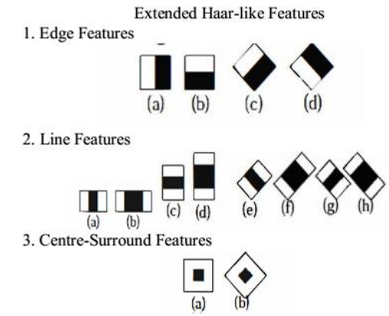
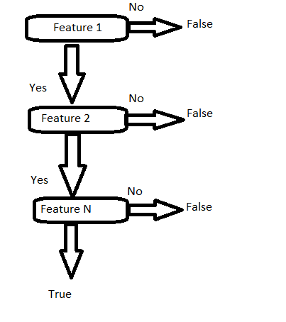
Working
SYSTEM DESIGN:

Slide 12
Working
We capture frames from the camera using cv2.VideoCapture.
Faces are detected using the Haar cascade classifier haarcascade_frontalface_default.xml.
We calculate the speed of each detected face by comparing their positions in consecutive frames and dividing by the time elapsed.
Distance estimation is not included here but can be added by incorporating camera calibration parameters and known object dimensions.
The loop continues until the user presses 'q'.
Finally, we release the camera and close all OpenCV windows.
Please note that this is a simplified example, and for accurate speed and distance estimation, additional calibration and filtering techniques may be required.

Slide 13
Working
Implementing software for face detection using OpenCV with the ability to calculate speed and distance between the camera and face involves several steps. Below is a basic implementation outline in Python:
Initialize the Camera: Use OpenCV's VideoCapture class to initialize the camera.
Face Detection: Utilize OpenCV's face detection algorithms such as Haar cascades or deep learning-based models (SSD, YOLO) to detect faces in each frame.

Slide 14
Working
Speed Calculation
Track the detected faces across consecutive frames to calculate their displacement.
Measure the time elapsed between frames to determine the speed.
Optionally, convert the pixel displacement to real-world units using a calibration factor.
Distance Estimation:
Calibrate the camera to obtain intrinsic and extrinsic parameters.
Determine the distance between the camera and the detected face using techniques such as triangulation or depth sensing.
Convert the pixel distance to real-world units using the calibration factor.
Display Results: Draw bounding boxes around the detected faces and display the calculated speed and distance.

Slide 15
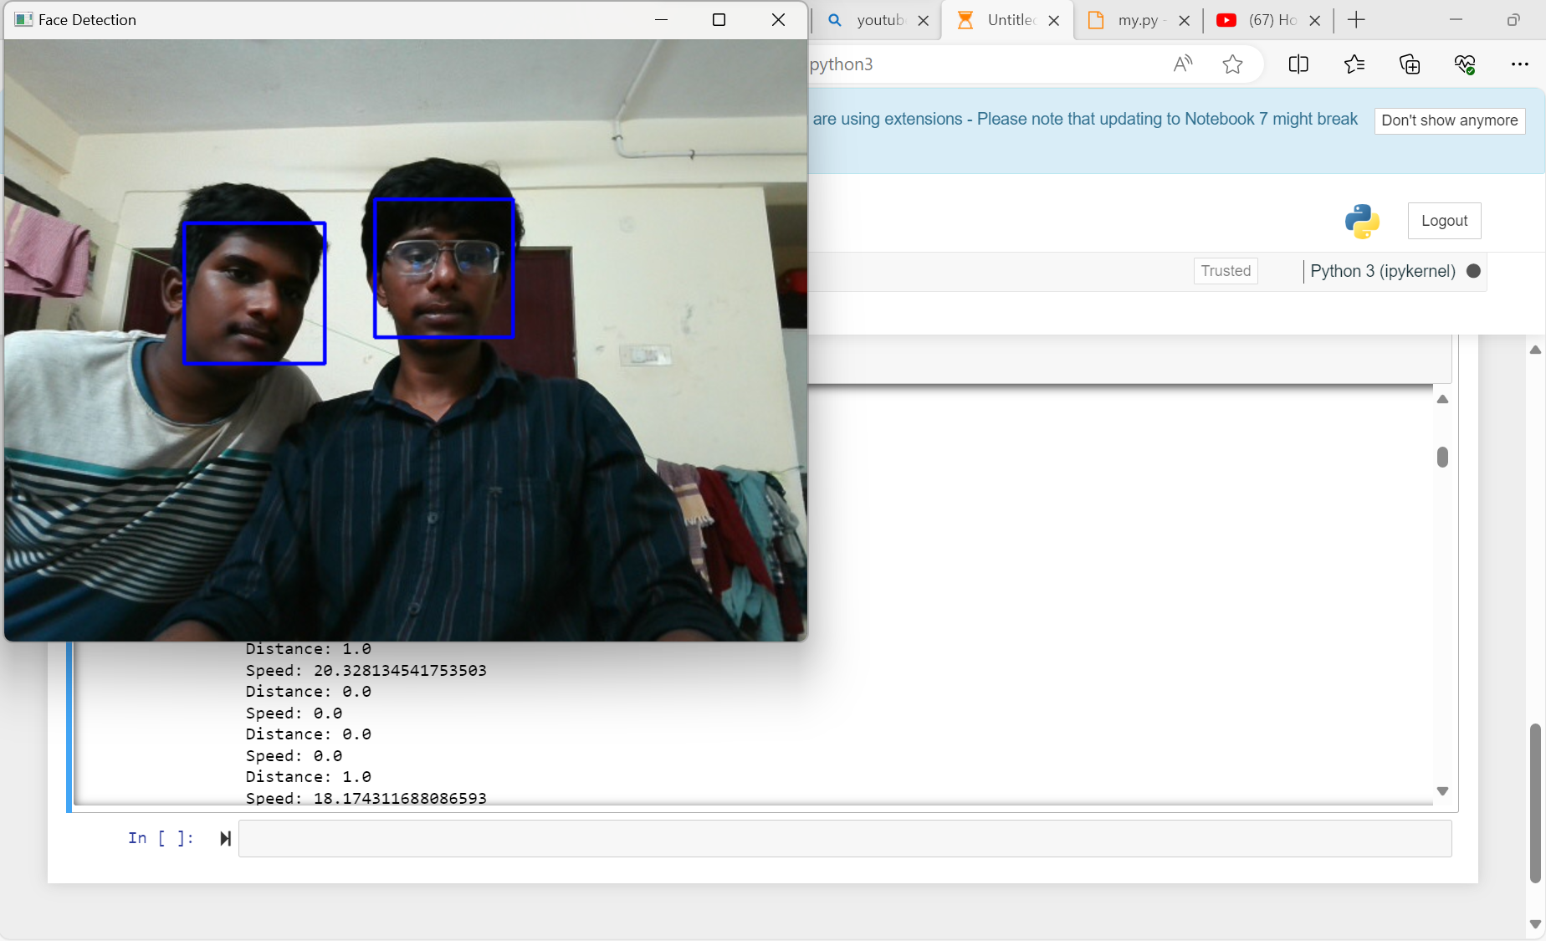
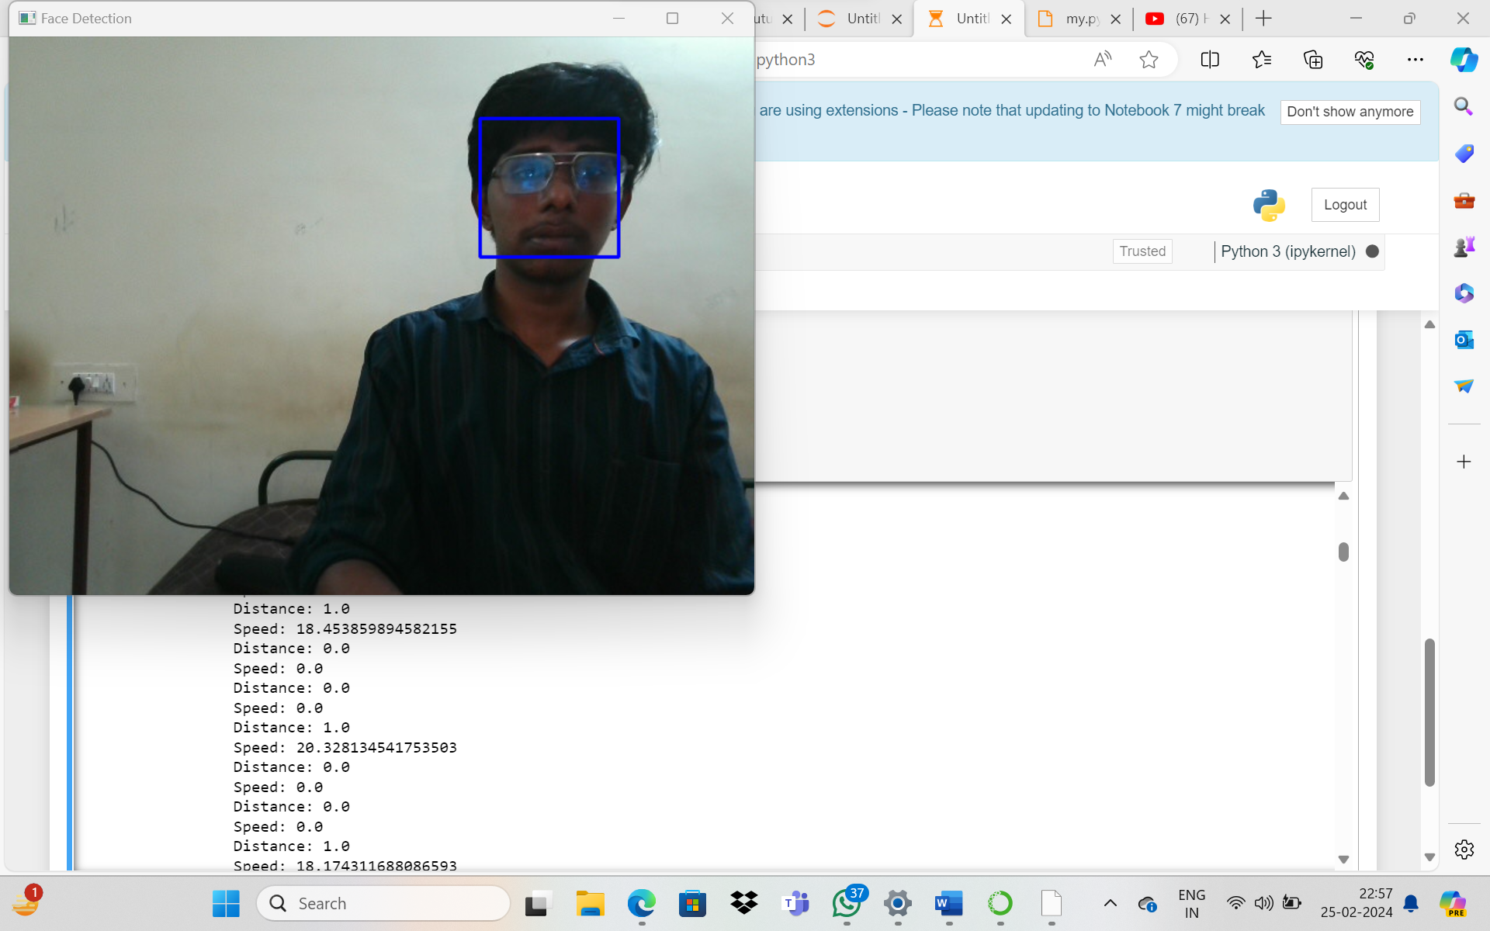
Results and Discussion

Slide 16
Results and Discussion
Figure displays the outcome of the face detection process. They are the HD video streaming frames that were taken out. Even though there are just one or two face in the frame, the face detection system occasionally produces many results.
In this instance, OpenCV and Simple CVHaar Classifier packages are utilised in post-image processing to retrieve the precise facial coordinates. The distance between the centre points of these rectangles has been determined if the system outputs more than one rectangle to represent the position of the face. The average of these rectangles will be calculated and used as the final position of the identified face if the distance is less than a predetermined threshold.

Slide 17
Results and Discussion
In this study, we also use face detection to create the face tracking programme in Python. Through testing and debugging our codes, this method is confirmed, and the scheme's limits are noted.
The speed of this face tracking system is then evaluated using OpenCV due to Python's performance limitations. We discovered that Viola and Jones face detection is faster and better suited for real-time face recognition because it uses less CPU power.

Slide 18
Summary
This study proposes an integrated system for face detection using OpenCV, capable of simultaneously calculating the speed and distance between the camera and detected faces in real-time. Leveraging OpenCV's extensive library of computer vision algorithms, the system employs both traditional methods like Haar cascades and modern deep learning-based models such as SSD or YOLO for face detection. Subsequent to face detection, the system incorporates algorithms for speed estimation by tracking the detected faces across consecutive frames, employing techniques like optical flow or Kalman filtering for motion analysis.
Additionally, distance estimation is addressed through camera calibration techniques and depth perception algorithms. By combining these functionalities within an OpenCV framework, the system enables efficient real-time face detection with concurrent speed and distance analysis, applicable across various domains including surveillance, human-computer interaction, and automotive safety systems. Experimental evaluation confirms the effectiveness and accuracy of the proposed methodology in diverse real-world scenarios, showcasing its potential for deployment in practical applications requiring robust face detection alongside dynamic speed and distance assessment.

Slide 19
References
OpenCV Documentation:
website:
OpenCV Documentation
Computer Vision Textbooks:
"Computer Vision: Algorithms and Applications" by Richard Szeliski
"Computer Vision: Principles, Algorithms, Applications, Learning" by E. R. Davies
Face Detection with OpenCV and Dlib:
Real-time Face Tracking and Speed Estimation:
Online course on Coursera

Slide 20


